Slide 1


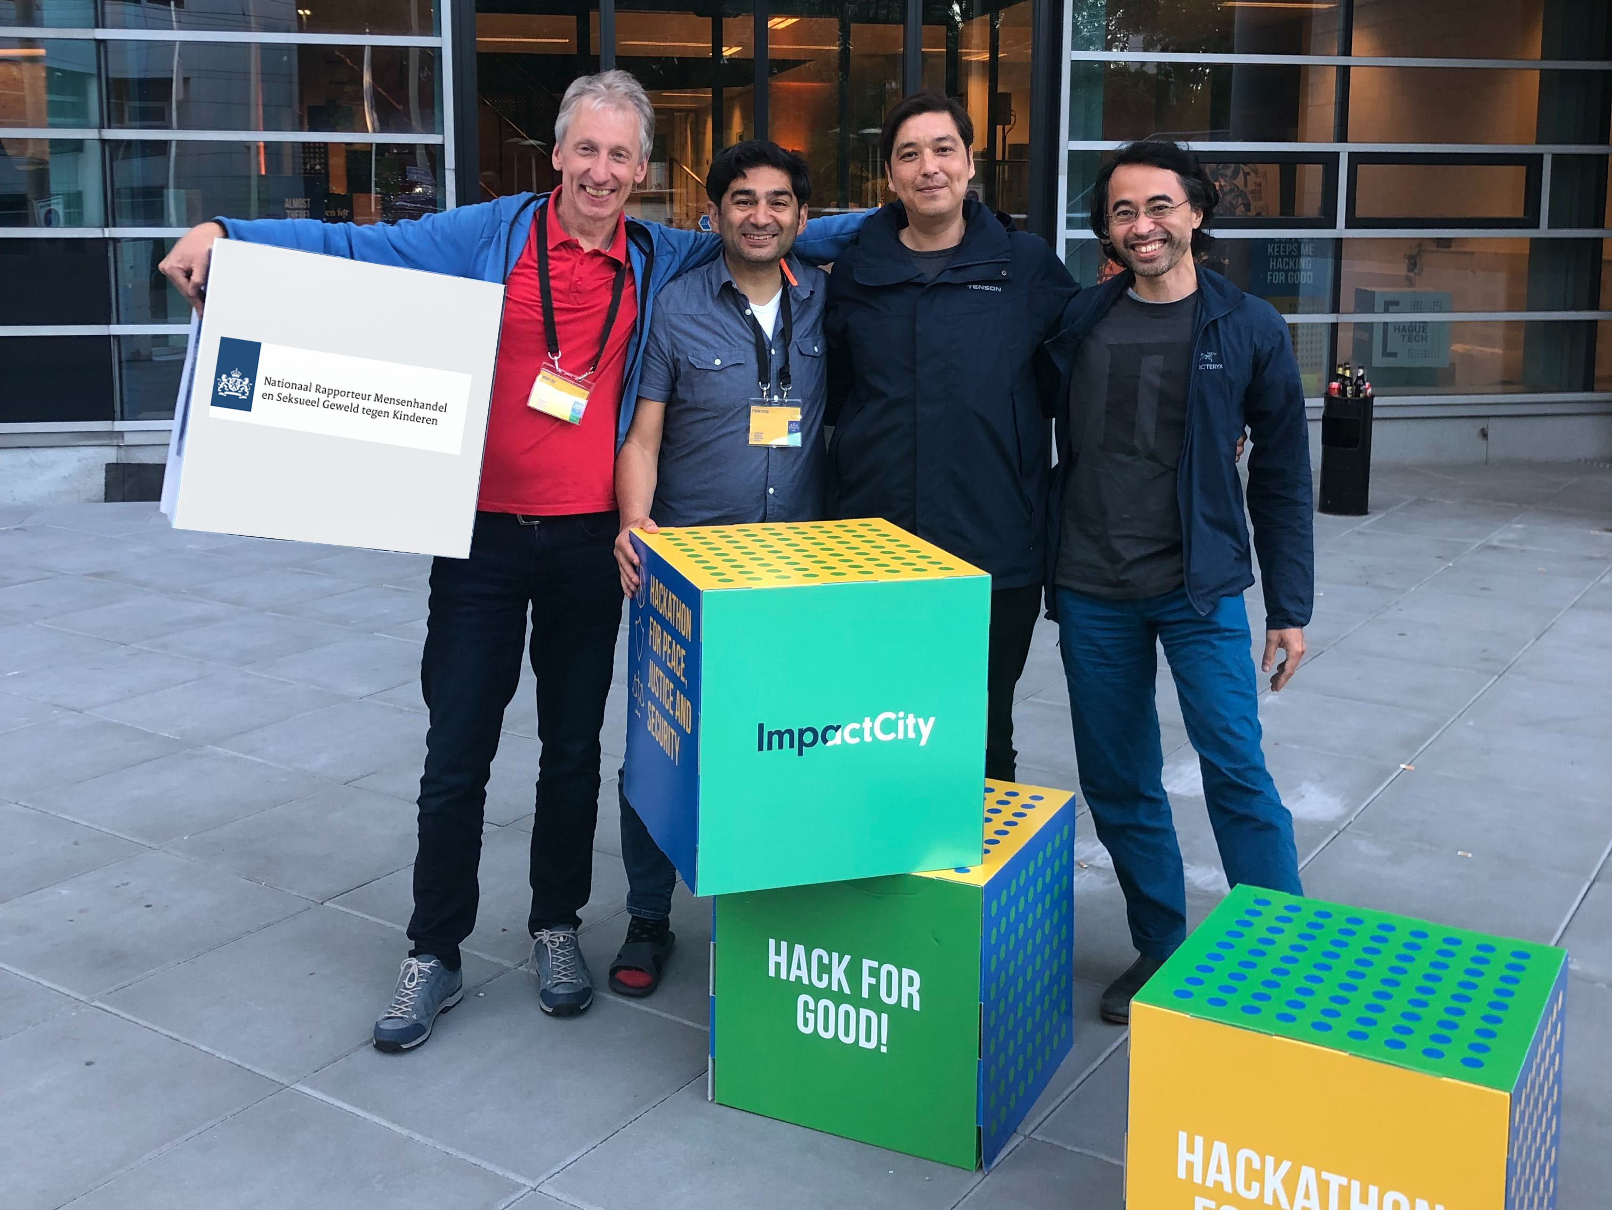
NRTeam1

Slide 2
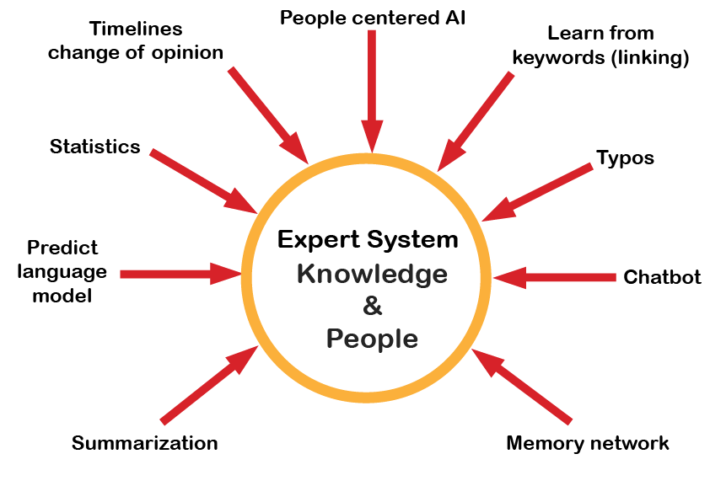

MVP

Slide 3

Search
Inter-action
Presentation
Reporting
Intelligence
Database

Slide 4
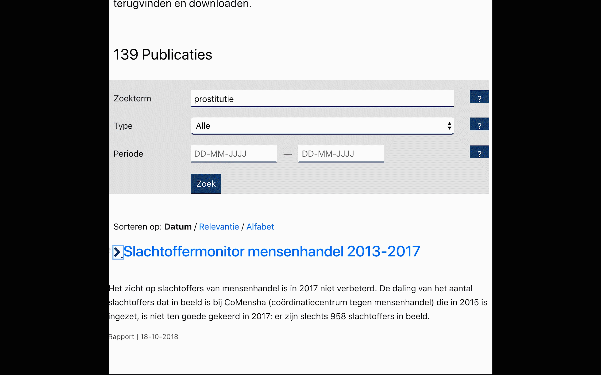
MVP

Slide 5

The real
Challenge

